Slide 1


PYTHON PROJECT: Limit Order and Market Order Application
SHEHAB RASLAN
HOOMAN HALABICHIAN
BASMA EL KHAMLICHI
YOUSSEF EL BQAQ
MOHAMAD DAKKOURI
SATNAM SINGH

Slide 2
OUTLINES
Introduction
Code Rationale
Python Application
Visualizations
Conclusion & Code Improvement
References

Slide 3
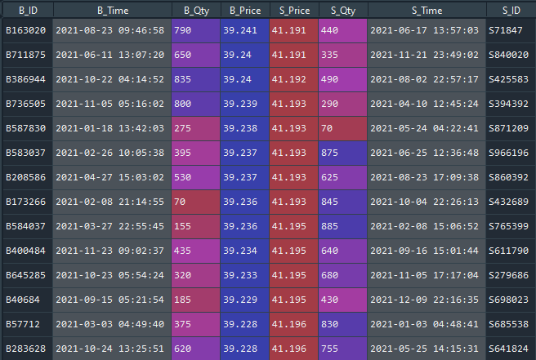
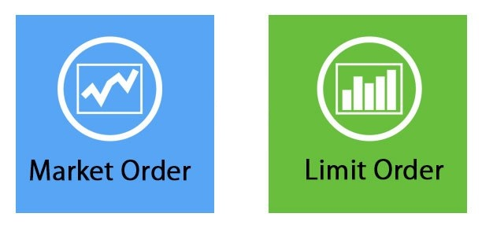
I- INTRODUCTION
SELL
BUY
Quantity
Px Limit

Slide 4
Code Rationale
Market Order
Buy Order
Executed at the best sell price in the market
Sell Order
Executed at the best buy price in the market

Slide 5
Code Rationale
Limit Order
Buy Limit
Added to the order book if the limit price of the order is less than the best sell price
Executed if best ask price is less than or equal to the buy limit price
Sell Limit
Added to the order book if the limit price of the order is greater than the best buy price
Executed if best buy price is more than or equal to the sell limit price computed

Slide 6
PYTHON APPLICATION
Libraries used:
Pandas
Numpy
Random
Datetime

Slide 7
PYTHON APPLICATION (cont’d)
Code logic:
STEP 1 :
Setting-up some functions to produce a random order book
STEP 2 :
Generate 5000 random order (Buy/Sell ; Market/Limit)
Matching process of the orders
When 2 orders matches, generate in a txt file with the trade information
BONUS STEP :
Bonus Setting-up some functions to process to handle all the different possible inputs of the user

Slide 8
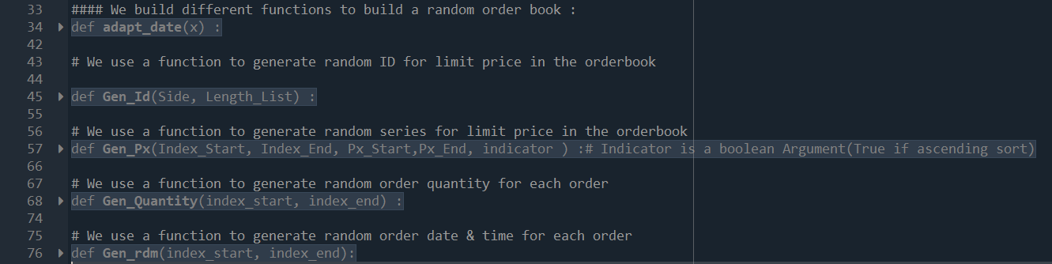
PYTHON APPLICATION: STEP 1
STEP 1: Setting-up some functions to produce a random order book

Slide 9
PYTHON APPLICATION: STEP 1

Slide 10
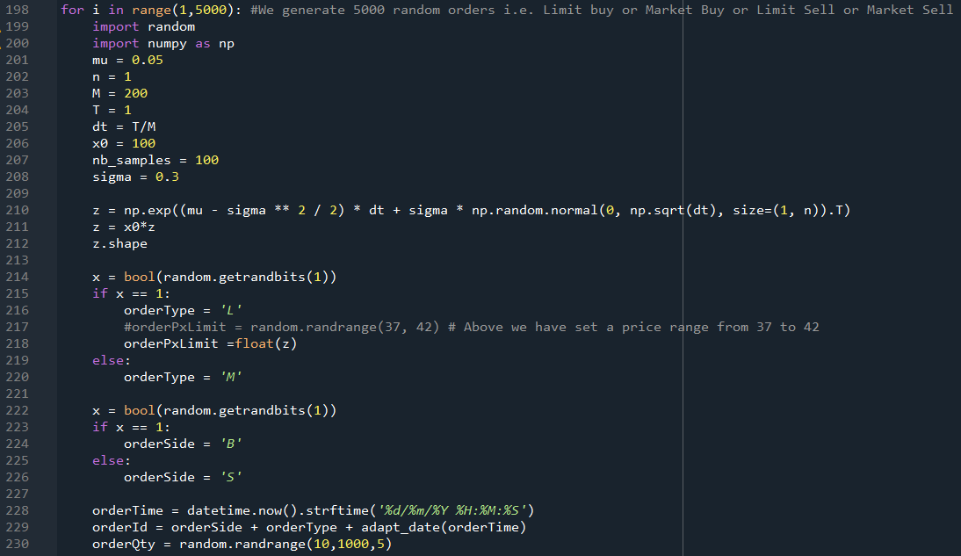
PYTHON APPLICATION: STEP 2
STEP 2: Generate 5000 random order (Buy/Sell ; Market/Limit)

Slide 11
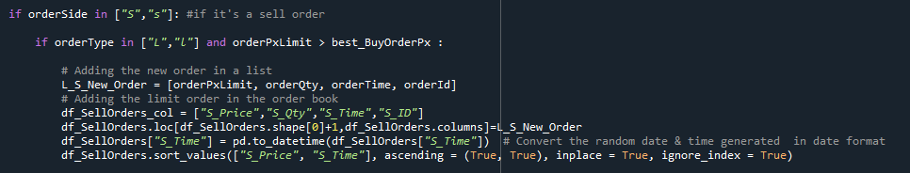
PYTHON APPLICATION: STEP 2
STEP 2: Matching process of the orders

Slide 12
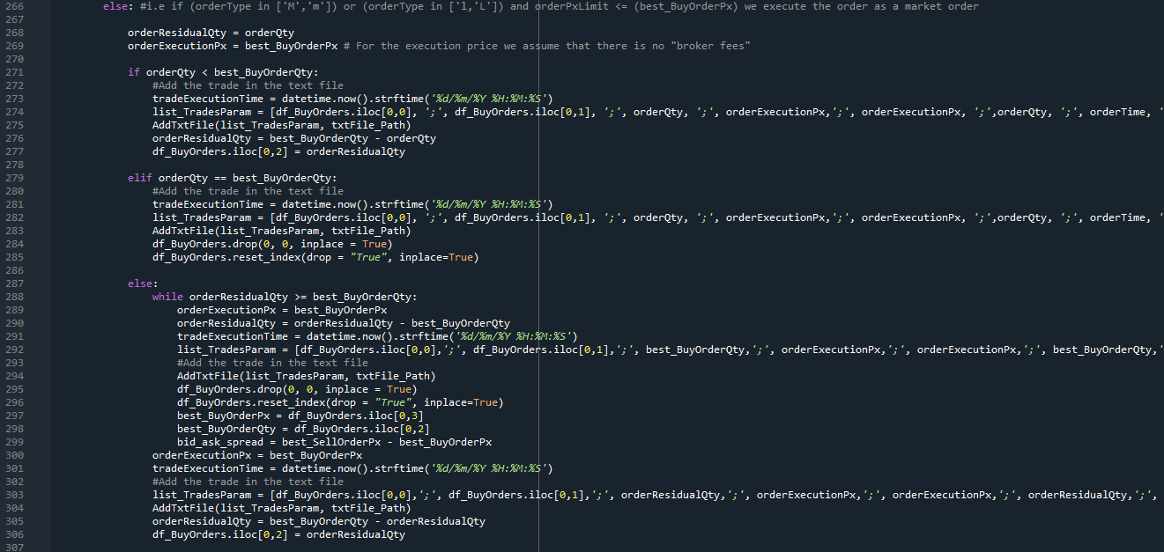
PYTHON APPLICATION: STEP 2
STEP 2: Matching process of the orders

Slide 13
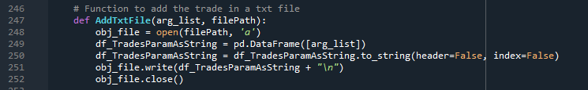
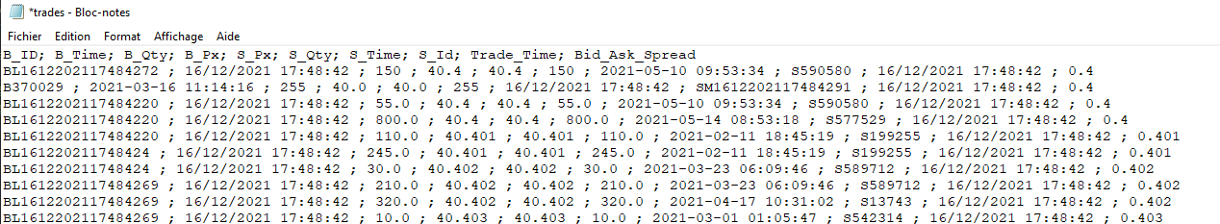
PYTHON APPLICATION: STEP 2
STEP 2: When 2 orders matches, generate in a txt file with the trade information

Slide 14
PYTHON APPLICATION: STEP 3
BONUS STEP : Let’s do a simulation

Slide 15
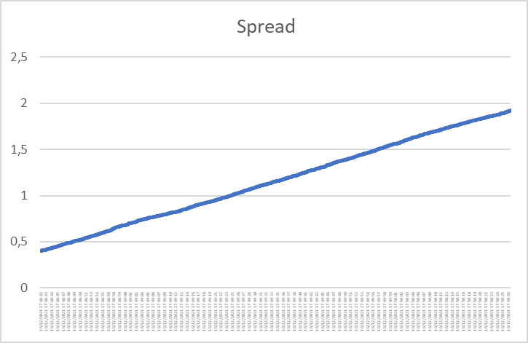
VISUALIZATIONS
First Case : We generate a spread variations depending on time with no initial conditions
(Random price and order) .
- Liquidity conditions are deteriorating

Slide 16
VISUALIZATIONS
Second Case : We generate a spread variations depend depending on time with a initial condition of 100 Sell
Market Orders .

Slide 17
VISUALIZATIONS
Third Case : We generate a spread variations depend depending on time with a initial condition of 100 Buy
Market Orders injected .

Slide 18
IV- CODE IMPROVEMENT & CONCLUSION
Integration of Object Oriented Programming and Function Oriented Programming to solve the problem
We developed the dates from scratch to better practice python, but we could’ve used built in functions.
Importance of comments to organize the code and be able to modify it when needed
Market Order vs Limit Order Program Dynamic
Matplotlib future integration to produce the graphs and visualization

Slide 19
REFERENCES
https://numpy.org/
https://www.w3schools.com/python/numpy/numpy_intro.asp
https://pandas.pydata.org/
https://www.w3schools.com/python/pandas/default.asp
https://docs.python.org/3/library/random.html
https://www.w3schools.com/python/module_random.asp
https://docs.python.org/3/library/datetime.html

Slide 20

THANK YOU FOR YOUR ATTENTION

